Slide 1

Data Scientist
ProjeCt 3
Prepare data for a public health organization
Is it possible to suggest values for certain fields when adding a new product to the database ?
Notes:
Context:
Open Food Facts is a database of food products opened to everyone.
Add a new product -> fill in numerous text and numerical fields -> can lead to errors and missing values
Question:
Is it possible to suggest values for certain fields when adding a new product in order to reduce input errors and missing values in the Open Food Facts database?

Slide 2
Agenda
I. Data exploration
II. Data cleaning
III. Outliers detection
IV. Missing values imputation
V. Completed dataset analysis
VI. Conclusion
Notes:
Explore data
Data cleaning : Basic cleaning + Choose a target which we’d like to suggest values for. Only 1 target for the moment, just to evaulate the feasibility of the overall project
NOTE : THIS PROJECT DOESN’T COVER THE VALUE SUGGESTION PART,
ONLY PREPARING THE DATASET:
Select relevant features
Identify and handle outliers
Impute missing values
Once we have a completed dataset , we’ll perform different types of analysis (univariate and multivariate) and try to reduce the dimensionality of the dataset by applying PCA (principle component analysis)

Slide 3
I
Data exploration

Slide 4
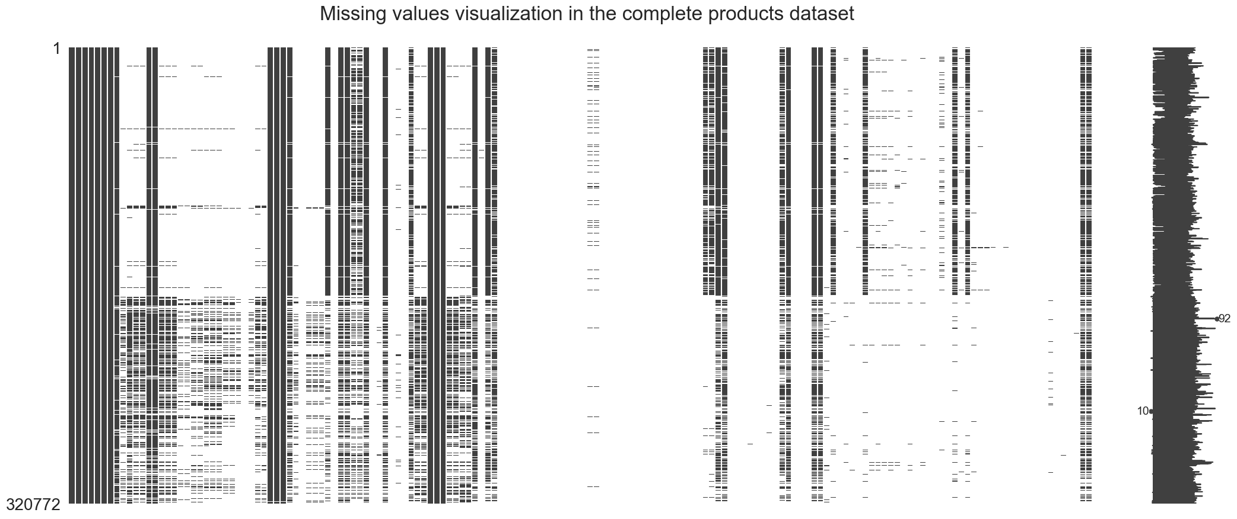
Data exploration
320 772 rows (products) and 162 columns (nutrients, product category, ingredients, general information, …)
Insights
A lot of missing values
Some of the string columns are not standardized
Some of the string columns are actually list-like columns
Duplicated columns (countries, countries_fr, countries_tags)
Even normalized columns (ending with « _tags ») are not perfect
Notes:
Description of the dataframe
Nutrients : per 100g of food
Missing data: white = missing, black = not missing
Insights:
Not standardized = not the same format for every string (uppercase / lowercase for example)
List-like columns : example = ingredients
Duplicated columns = according to the documentation : _tags = most normalized / standardized
Normlized columns not perfect:
Countries_tags : different languages, sometimes even a city instead of a country
Main_category : really similar categories with different names (concentrated orange juices vs orange juices)

Slide 5
II
Data cleaning

Slide 6
Data cleaning
Basic cleaning
Target choice and filtering
Normalization and clustering
Removed some products with mixed columns
Replaced some values ("unknown", "null", "unavailable", …) with NaN
Removed 21 empty columns
Removed obvious duplicated columns
Example: countries, countries_fr, countries_tags
Removed correlated features
The ones not bringing relevant additional information
Target = pnns_groups_2 (77% missing / 36 unique values)
Normalization
Clustering
Setting to lowercase, removing accents, underscores, consecutive whitespaces, etc
String similarity (like Levenshtein distance)
DBSCAN
Only keep products for which we have data for the target 248 882 products removed
Only keep features with sufficient data 106 columns removed
Drop duplicated products 2 822 products removed
Remove columns that are considered useless to predict the chosen target 8 columns removed
Notes:
Basic columns:
1. Removed a few products (23) which were not usable because their columns were mixed up
2. Replaced a few values in string columns with missing values
3.
4. According to the documentation: ending with _tags = standardized / normalized
5. Example: pnns_groups_2 are subcategories of pnns_groups_1 -> Remove pnns_groups_1
Example: nutrition_grade_fr (from A to E) / nutrition_score -> Remove nutrition grade
Target choice and filtering:
Pnns_groups_2 : "high-level" category of products, example of values : « eggs », « milk and yogurt »
Remove the target from the dataset
Normalization and clustering:
Goal : Later = KNN. Goal: reduce the number of unique values to improve accuracy of distance calculation
Normalization:
Exception: countries_tags with geopy and googletranslate API (example: Marseille -> France)
Clustering:
Exception: main_category by measuring the distance between the different main_categories (example: nectar and fruit juices / apple juices)

Slide 7
III
Outliers detection

Slide 8
Outliers detection
A nutrient amount cannot exceed 100g
By definition for 100g of food
Sum of macronutrients cannot exceed 100g
By definition for 100g of food
Sugars amount cannot exceed carbs amount
Sugars are included in carbs
Sat. fats amount cannot exceed fats amount
Sat. fats are included in fats
Energy cannot exceed maximum energy
Pure fat is 900 kcal
Notes:
Outlier rules :
Nutrient > 100g -> NaN
Sodium > 40g (maximum in salt) -> NaN
Sum of macronutrients = Carbs + proteins + fats > 103 -> NaN
Sugars > Carbs -> Sugars = Carbs
Saturated fat > fat -> Saturated fat = fat
Energy: Several units mixed up (kcal and kJ)
Food giving the most energy (kcal) is pure fat : 1g = 9 kcal -> 100g = 900 kcal
Max kJ amount = 900 kcal * 4,2
Value < 900 : kcal, no action
900 < value < 3750 : kJ -> divided by 4,2
Value > 3750 -> NaN
IQR rule not suitable in this case

Slide 9
IV
Missing values imputation

Slide 10
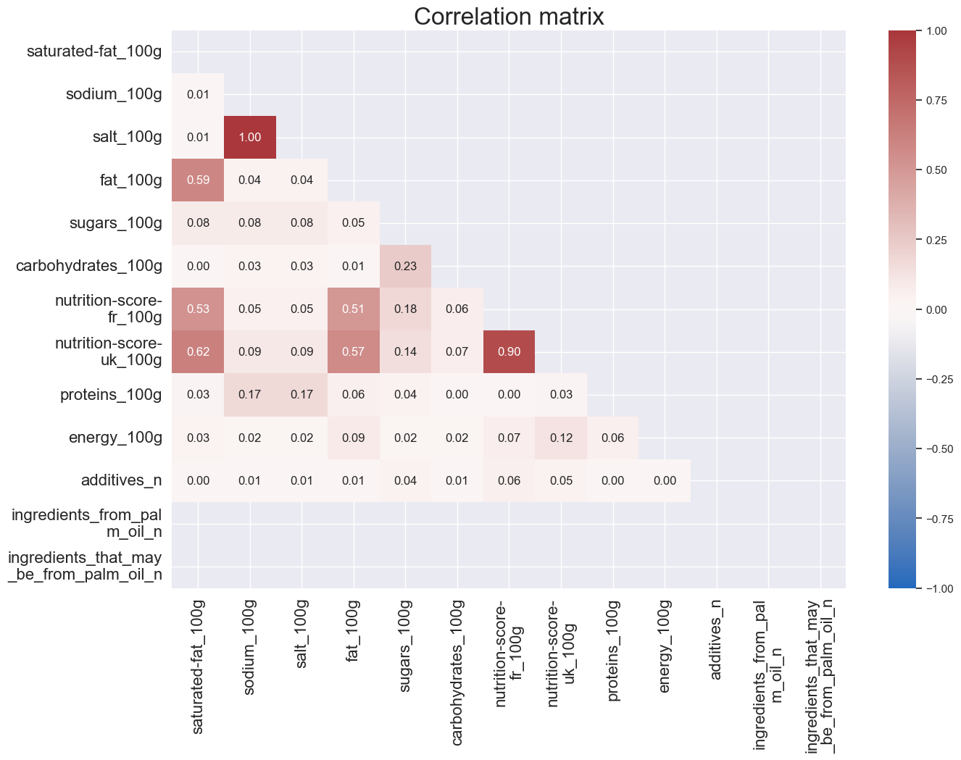
Missing values imputation
Linear regression
Conditions
Important correlation (R > 0.9)
At least 100 data points
Relevance
Very little data to predict
Cleaning
Remove correlated features
Notes:
Correlation matrix
Talk about correlated features where no value could be predicted
Wasn’t really relevant because very little data to predict but allowed to identify highly correalted values and remove them
Removed features: salt_100g, nutrition-score-fr_100g

Slide 11
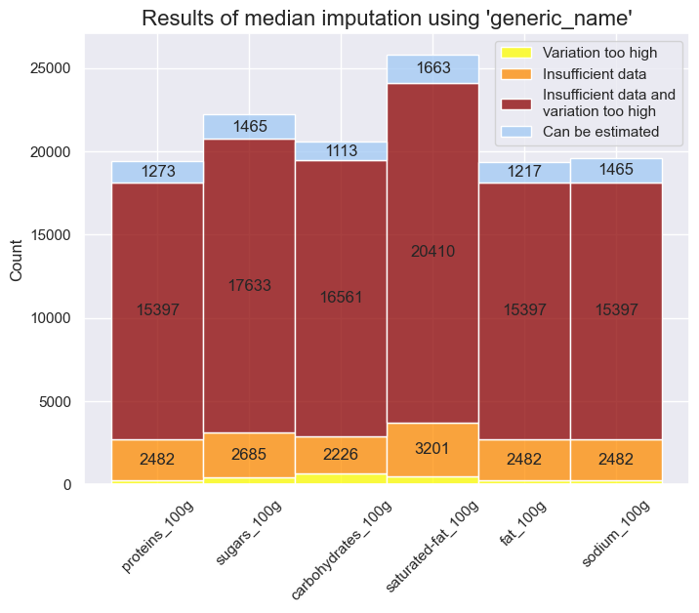
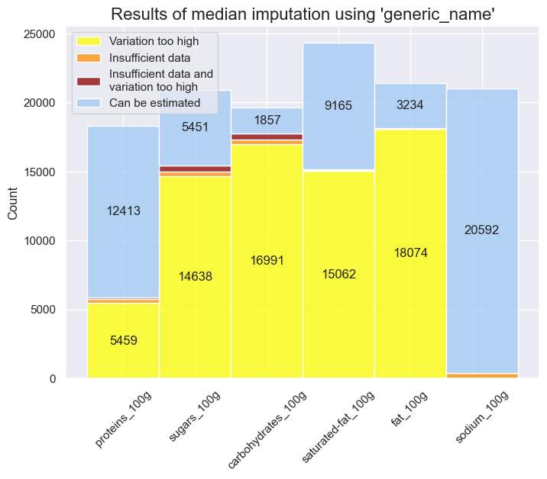
Missing values imputation
Median imputation (nutrients columns)
Using « generic_name »
Using « main_category »
Conditions
Low variance (std < 3)
At least 10 data points
Conditions
Low variance (std < 3)
At least 20 data points
Notes:
For each nutrient column, it is looking for products with the same generic name. And the group of products has to meet the conditions of variance and count.
Blue: the portion of data which could be estimated based on those conditions
Red: None of the conditions were met
Orange: Insufficient data
Yellow : Variation too high -> accuracy would be quite low if imputed those values as well
Generic name : most common issue to impute : None of the conditions are met
Main_category : most common issue to impute = Variance because main_category groups are a lot wider
Exception : sodium_100g

Slide 12
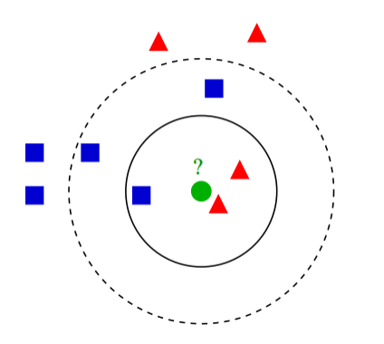
Missing values imputation
K-Nearest Neighbors
Custom metric to calculate the distance
String similarity (Levenshtein like)
List similariry
Basic difference for numbers
→ Euclidian distance
Presence of string data
 | Generic name | Ingredients | Energy
 | Tomato sauce | salt, tomato, sugar, flavour | 379
 | Tomato ketchup | tomato, water, concentrated tomato | 278
Distance | 38% | 71% | 101
Notes:
Deduce missing values based on the closest data points
Example in 2 dimensions
Calculate the distance between each individual (product in our case)
Strings : How similar are they ? By counting the number of characters for which there’s a match over the total number of characters
listlike : Same principle as for the strings : Count the number of elements for which there’s a match over the total number of elements
For each missing value -> look for its 10 nearest neighbors -> Aggregate the values from those nearest neighbors to estimate the missing value
For string values : take the mode, the most frequent value
For listlike values : The most commons values (at least appearing 3 times in the neighbors, arbitrary)
For numerical values : median

Slide 13
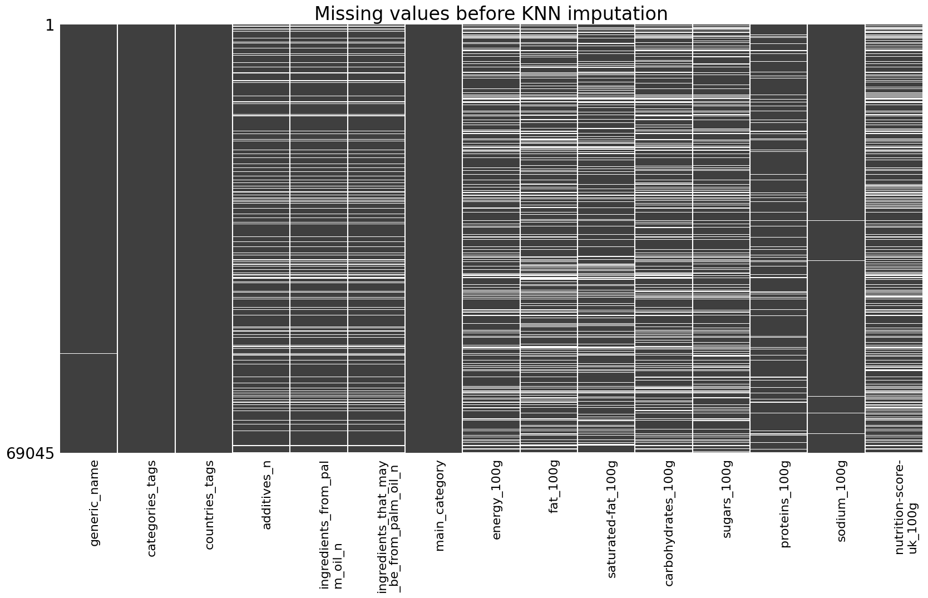
Missing values imputation
K-Nearest Neighbors and remaining missing values

Slide 14
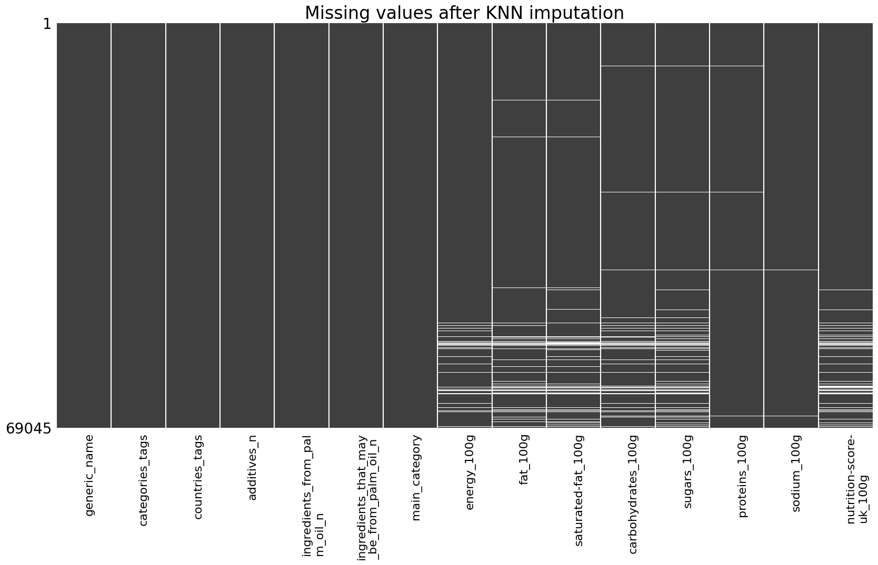
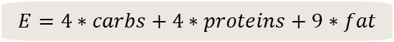
Missing values imputation
K-Nearest Neighbors and remaining missing values
Completing remaining values
Nutrients + nutrition score
using median imputation with « main_category »
Conditions
Low variance (std < 3)
At least 5 data points
Energy using specific rule
$$E=4∗carbs+4∗proteins+9∗fat$$
Notes:
Energy specific rule : alcohol amount should be included as well (7kcal per g) but not so muchproducts with alcohol

Slide 15
V
CompleteD dataset analysis

Slide 16
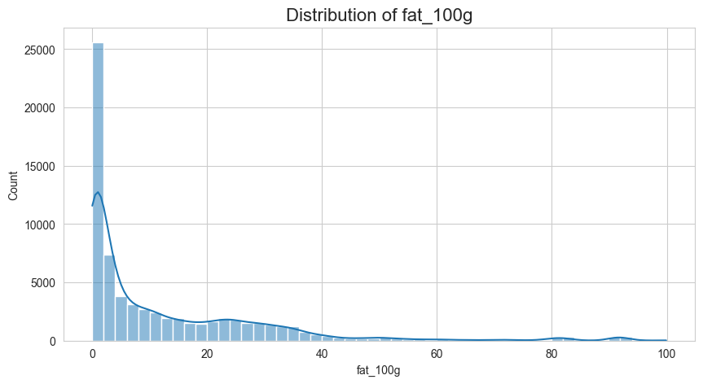
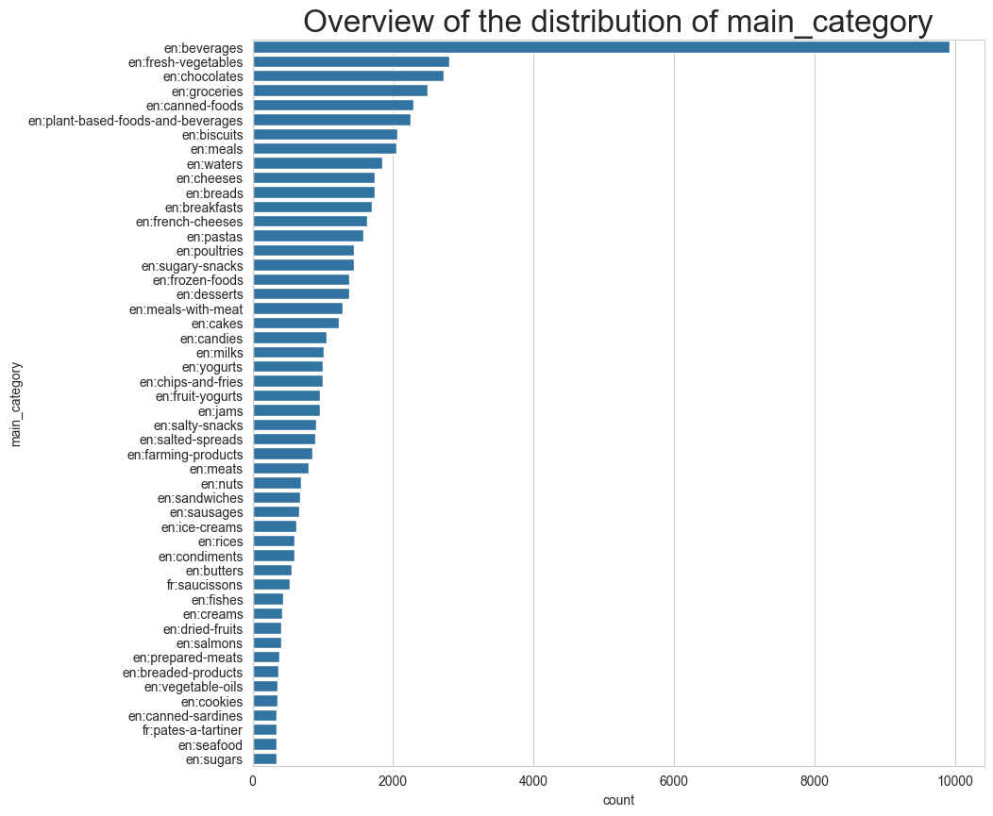
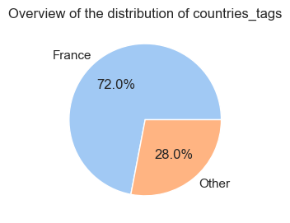
CompleteD dataset analysis
Univariate analysis overview
Notes:
Later : PCA
seems to work better with normal distribution
Nutrients distribution : long tail = skewed data -> Apply log
Countries : mostly France -> Might actually not be the case in the rest of the dataset (the part of the raw dataset with no pnns_groups_2 value), from what I saw there are a lot of USA products
Main_category : a lot of beverages, clustering on main_categories might be inducing this but this category is also really broad (a lot of juices, etc…) might be better to split it in several categories

Slide 17
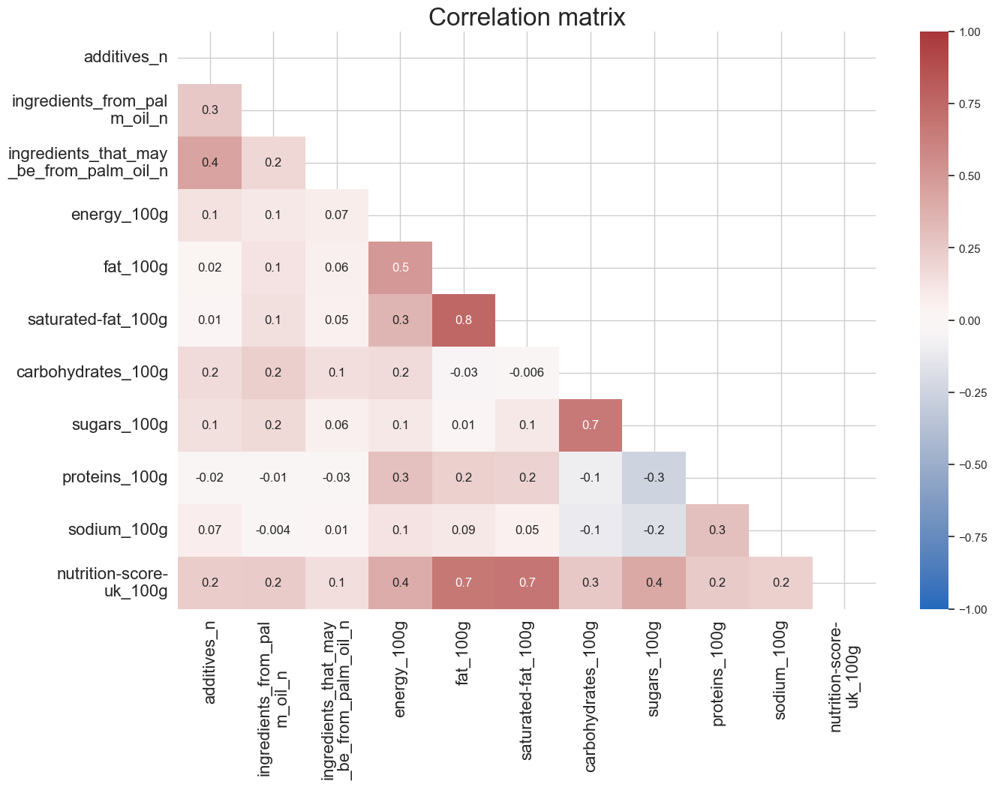
CompleteD dataset analysis
Bivariate analysis overview
Notes:
There are some correlations:
Saturated-fat / fat
Nutrition score / fat
Sugars / carbohydrates

Slide 18
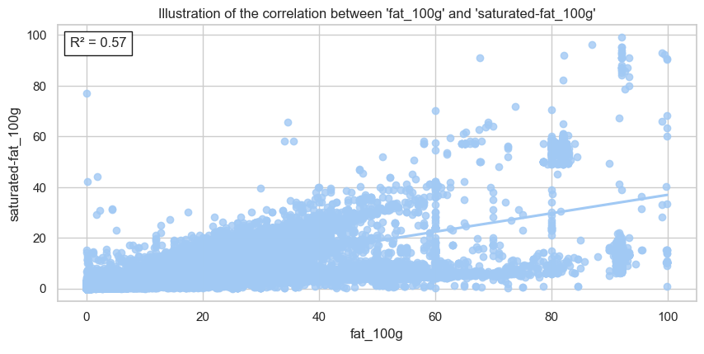
CompleteD dataset analysis
Bivariate analysis overview
Notes:
We see some outliers induced by knn imputation (saturated fat > fat)

Slide 19
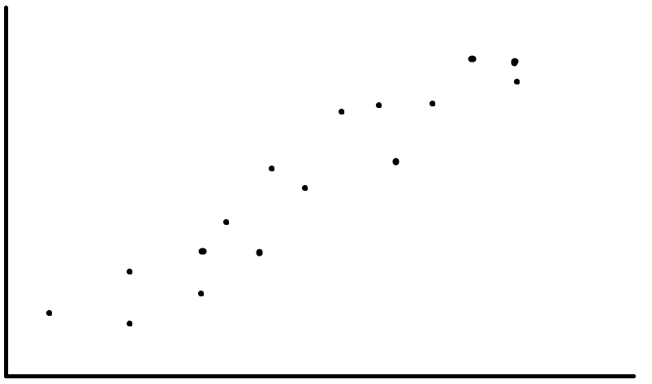
CompleteD dataset analysis
Multivariate analysis: PCA
Notes:
Principal component analysis
Goal : reducing the number of features or the number of products to only keep minimal relevant information.
To explain how this works, i am gonna take the example of 2 dimensional data
PCA with only a few of the numerical variables

Slide 20
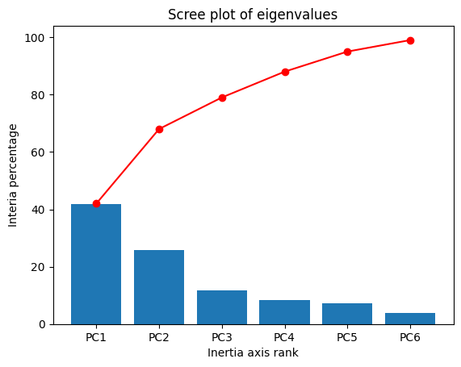
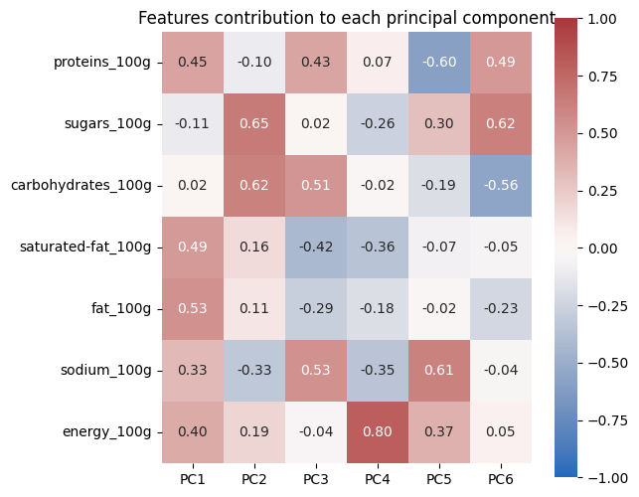
CompleteD dataset analysis
Multivariate analysis: PCA
Notes:
Principal component analysis
Goal : reducing the number of features or the number of products to only keep minimal relevant information.
PCA with only a few of the numerical variables to be more readable and easier to interpret
Scree plot : Percentage of information grabbed by each PC
Features contribution :
Shows the contribution of each feature for each principal component
each principal component is a linear combination of the features

Slide 21
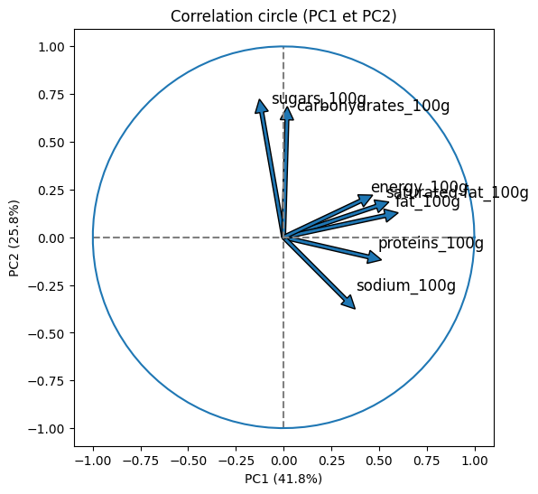
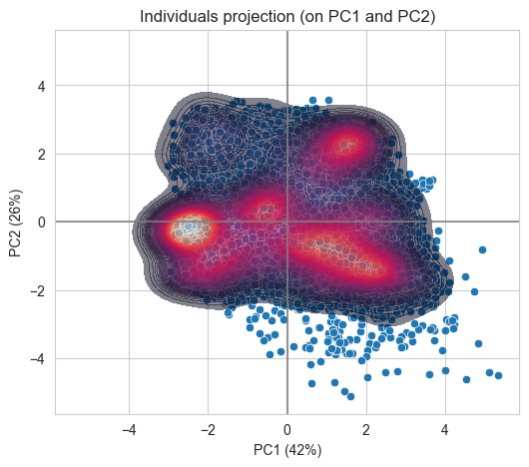
CompleteD dataset analysis
Multivariate analysis: PCA
Notes:
We’ll only look at the first 2 principal components
The closer an arrow is to an axis, the more it contributes to it / the more it is related to it
The longer the arrow, the better the representation of that feature is : sugars + carbs quite well represented
Interpretation of correlation circle:
First axis = energy
Energy, fat, saturated fat, proteins
Second axis = carbs
Sugars vs sodium
Interpretation of individuals projection:
High density area = no energy, no sugar, no sodium = waters ?
We could consider those products as duplicated

Slide 22
VI
conclusion

Slide 23
Alternatives & Possible improvements
Remove products with most missing values
In order to avoid questionable imputation methods after KNN, and reduce the distances computation time
Use other features
Results
Quantity units for example, which might be quite easy to impute
Running KNN on less features
Got a complete dataset to perform ML training for suggestions
BUT
Accuracy of imputation is limited
Dataset might not be representative of the overall data.
Still some outliers to handle
Might lead to better results
Apply weights in the distance calculation
Might make the neighbors search more accurate but might also be hard to tweek by hand

Slide 24
Thank you
Maxime Carré

Slide 25
VII
appendix

Slide 26
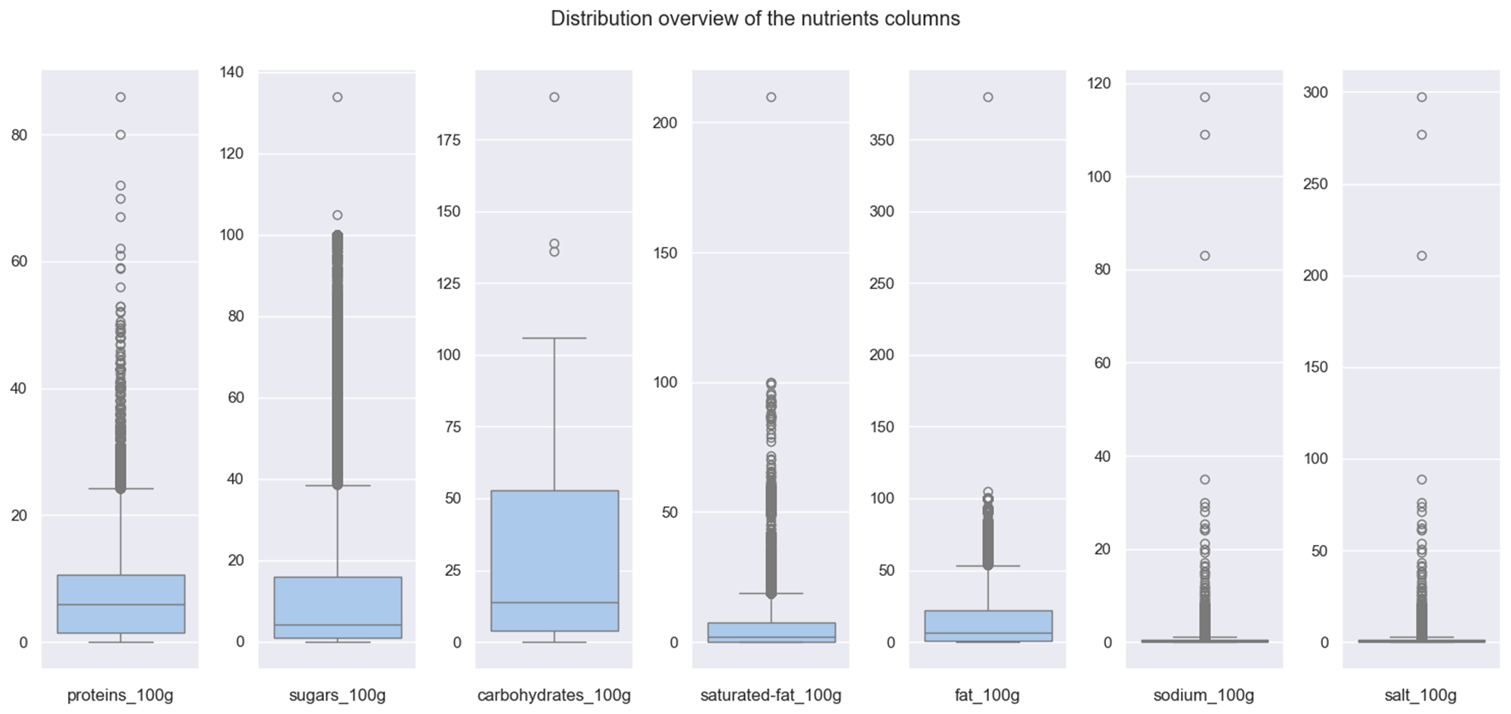
Outliers detection
Notes:
Outlier rules :
Nutrient > 100g -> NaN
Sodium > 40g (maximum in salt) -> NaN
Sum of macronutrients = Carbs + proteins + fats > 103 -> NaN
Sugars > Carbs -> Sugars = Carbs
Saturated fat > fat -> Saturated fat = fat
Energy: Several units mixed up (kcal and kJ)
Food giving the most energy (kcal) is pure fat : 1g = 9 kcal -> 100g = 900 kcal
Max kJ amount = 900 kcal * 4,2
Value < 900 : kcal, no action
900 < value < 3750 : kJ -> divided by 4,2
Value > 3750 -> NaN
IQR rule not suitable in this case

Slide 27

Outliers detection
Notes:
Outlier rules :
Nutrient > 100g -> NaN
Sodium > 40g (maximum in salt) -> NaN
Sum of macronutrients = Carbs + proteins + fats > 103 -> NaN
Sugars > Carbs -> Sugars = Carbs
Saturated fat > fat -> Saturated fat = fat
Energy: Several units mixed up (kcal and kJ)
Food giving the most energy (kcal) is pure fat : 1g = 9 kcal -> 100g = 900 kcal
Max kJ amount = 900 kcal * 4,2
Value < 900 : kcal, no action
900 < value < 3750 : kJ -> divided by 4,2
Value > 3750 -> NaN
IQR rule not suitable in this case

Slide 28
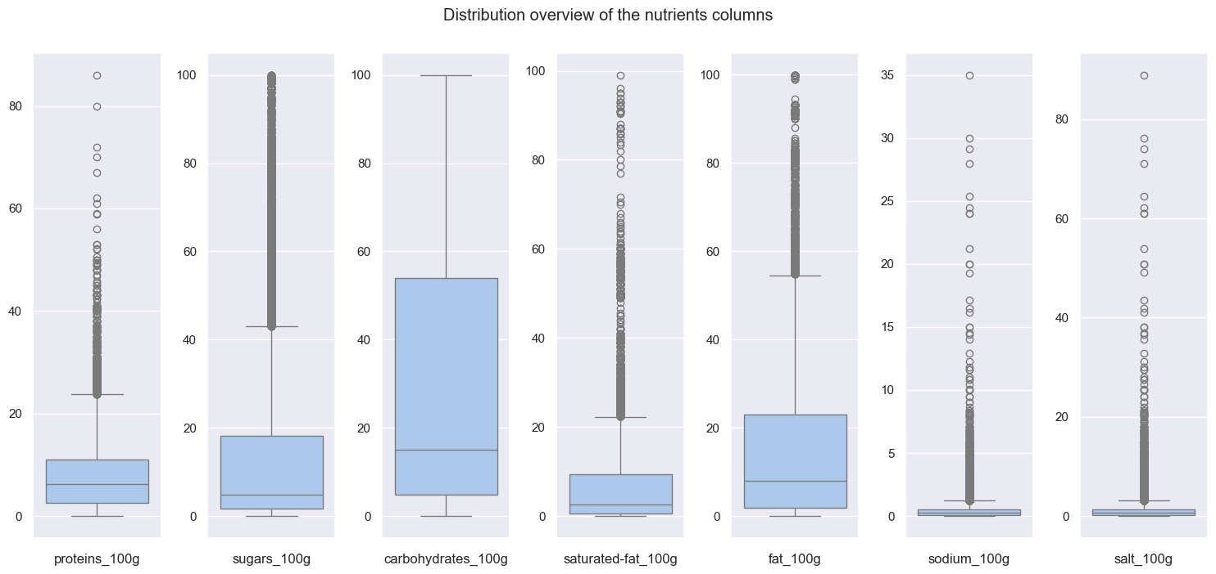
Outliers detection
Notes:
Outlier rules :
Nutrient > 100g -> NaN
Sodium > 40g (maximum in salt) -> NaN
Sum of macronutrients = Carbs + proteins + fats > 103 -> NaN
Sugars > Carbs -> Sugars = Carbs
Saturated fat > fat -> Saturated fat = fat
Energy: Several units mixed up (kcal and kJ)
Food giving the most energy (kcal) is pure fat : 1g = 9 kcal -> 100g = 900 kcal
Max kJ amount = 900 kcal * 4,2
Value < 900 : kcal, no action
900 < value < 3750 : kJ -> divided by 4,2
Value > 3750 -> NaN
IQR rule not suitable in this case

Slide 29
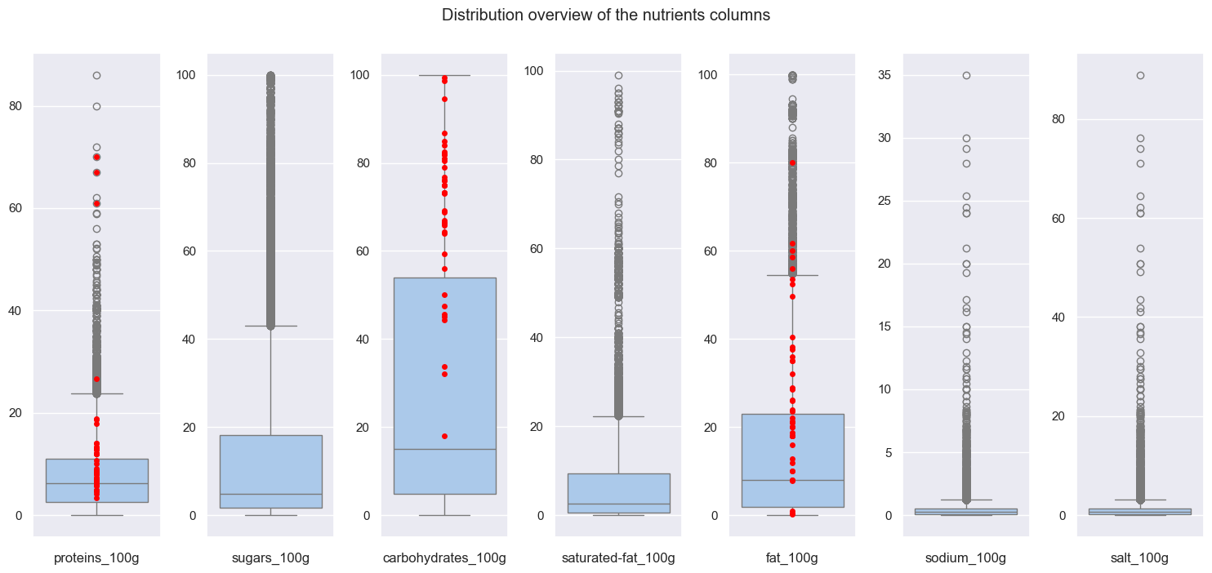
Outliers detection
Notes:
Outlier rules :
Nutrient > 100g -> NaN
Sodium > 40g (maximum in salt) -> NaN
Sum of macronutrients = Carbs + proteins + fats > 103 -> NaN
Sugars > Carbs -> Sugars = Carbs
Saturated fat > fat -> Saturated fat = fat
Energy: Several units mixed up (kcal and kJ)
Food giving the most energy (kcal) is pure fat : 1g = 9 kcal -> 100g = 900 kcal
Max kJ amount = 900 kcal * 4,2
Value < 900 : kcal, no action
900 < value < 3750 : kJ -> divided by 4,2
Value > 3750 -> NaN
IQR rule not suitable in this case

Slide 30

Outliers detection
Notes:
Outlier rules :
Nutrient > 100g -> NaN
Sodium > 40g (maximum in salt) -> NaN
Sum of macronutrients = Carbs + proteins + fats > 103 -> NaN
Sugars > Carbs -> Sugars = Carbs
Saturated fat > fat -> Saturated fat = fat
Energy: Several units mixed up (kcal and kJ)
Food giving the most energy (kcal) is pure fat : 1g = 9 kcal -> 100g = 900 kcal
Max kJ amount = 900 kcal * 4,2
Value < 900 : kcal, no action
900 < value < 3750 : kJ -> divided by 4,2
Value > 3750 -> NaN
IQR rule not suitable in this case

Slide 31
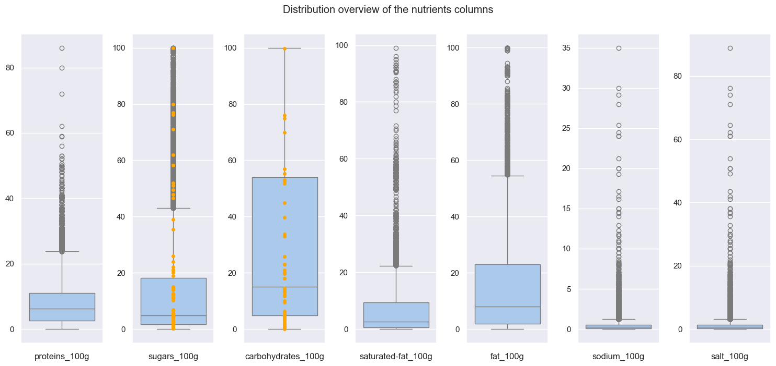
Outliers detection
Notes:
Outlier rules :
Nutrient > 100g -> NaN
Sodium > 40g (maximum in salt) -> NaN
Sum of macronutrients = Carbs + proteins + fats > 103 -> NaN
Sugars > Carbs -> Sugars = Carbs
Saturated fat > fat -> Saturated fat = fat
Energy: Several units mixed up (kcal and kJ)
Food giving the most energy (kcal) is pure fat : 1g = 9 kcal -> 100g = 900 kcal
Max kJ amount = 900 kcal * 4,2
Value < 900 : kcal, no action
900 < value < 3750 : kJ -> divided by 4,2
Value > 3750 -> NaN
IQR rule not suitable in this case

Slide 32
Outliers detection
Notes:
Outlier rules :
Nutrient > 100g -> NaN
Sodium > 40g (maximum in salt) -> NaN
Sum of macronutrients = Carbs + proteins + fats > 103 -> NaN
Sugars > Carbs -> Sugars = Carbs
Saturated fat > fat -> Saturated fat = fat
Energy: Several units mixed up (kcal and kJ)
Food giving the most energy (kcal) is pure fat : 1g = 9 kcal -> 100g = 900 kcal
Max kJ amount = 900 kcal * 4,2
Value < 900 : kcal, no action
900 < value < 3750 : kJ -> divided by 4,2
Value > 3750 -> NaN
IQR rule not suitable in this case

Slide 33
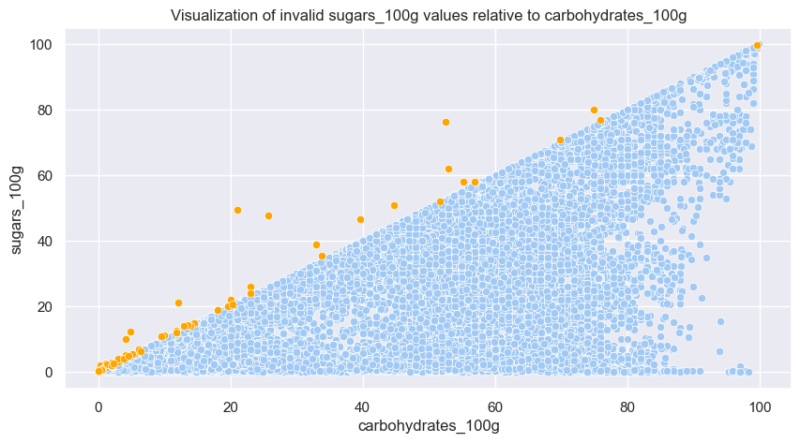
Outliers detection
Notes:
Outlier rules :
Nutrient > 100g -> NaN
Sodium > 40g (maximum in salt) -> NaN
Sum of macronutrients = Carbs + proteins + fats > 103 -> NaN
Sugars > Carbs -> Sugars = Carbs
Saturated fat > fat -> Saturated fat = fat
Energy: Several units mixed up (kcal and kJ)
Food giving the most energy (kcal) is pure fat : 1g = 9 kcal -> 100g = 900 kcal
Max kJ amount = 900 kcal * 4,2
Value < 900 : kcal, no action
900 < value < 3750 : kJ -> divided by 4,2
Value > 3750 -> NaN
IQR rule not suitable in this case

Slide 34
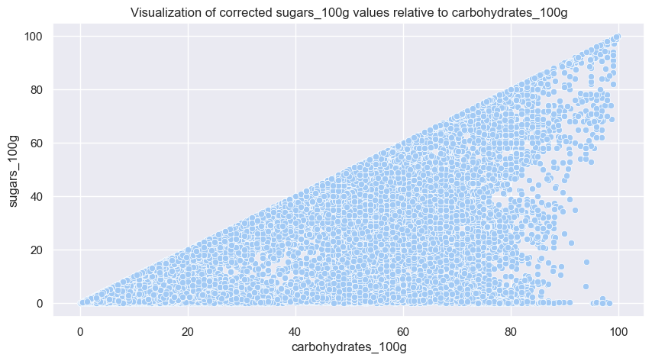
Outliers detection
Notes:
Outlier rules :
Nutrient > 100g -> NaN
Sodium > 40g (maximum in salt) -> NaN
Sum of macronutrients = Carbs + proteins + fats > 103 -> NaN
Sugars > Carbs -> Sugars = Carbs
Saturated fat > fat -> Saturated fat = fat
Energy: Several units mixed up (kcal and kJ)
Food giving the most energy (kcal) is pure fat : 1g = 9 kcal -> 100g = 900 kcal
Max kJ amount = 900 kcal * 4,2
Value < 900 : kcal, no action
900 < value < 3750 : kJ -> divided by 4,2
Value > 3750 -> NaN
IQR rule not suitable in this case

Slide 35
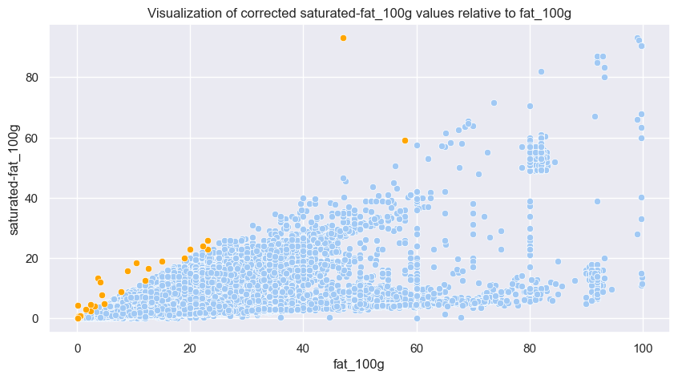
Outliers detection
Notes:
Outlier rules :
Nutrient > 100g -> NaN
Sodium > 40g (maximum in salt) -> NaN
Sum of macronutrients = Carbs + proteins + fats > 103 -> NaN
Sugars > Carbs -> Sugars = Carbs
Saturated fat > fat -> Saturated fat = fat
Energy: Several units mixed up (kcal and kJ)
Food giving the most energy (kcal) is pure fat : 1g = 9 kcal -> 100g = 900 kcal
Max kJ amount = 900 kcal * 4,2
Value < 900 : kcal, no action
900 < value < 3750 : kJ -> divided by 4,2
Value > 3750 -> NaN
IQR rule not suitable in this case

Slide 36
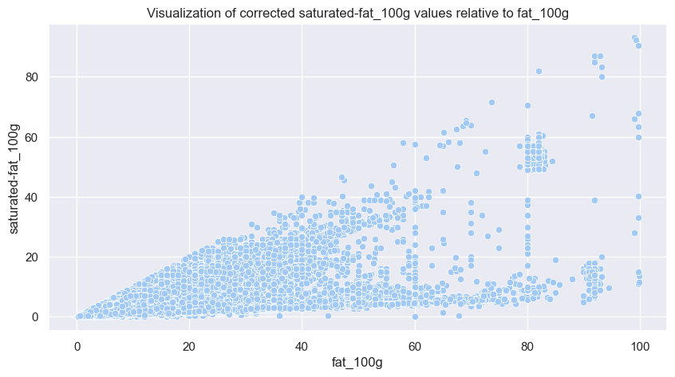
Outliers detection
Notes:
Outlier rules :
Nutrient > 100g -> NaN
Sodium > 40g (maximum in salt) -> NaN
Sum of macronutrients = Carbs + proteins + fats > 103 -> NaN
Sugars > Carbs -> Sugars = Carbs
Saturated fat > fat -> Saturated fat = fat
Energy: Several units mixed up (kcal and kJ)
Food giving the most energy (kcal) is pure fat : 1g = 9 kcal -> 100g = 900 kcal
Max kJ amount = 900 kcal * 4,2
Value < 900 : kcal, no action
900 < value < 3750 : kJ -> divided by 4,2
Value > 3750 -> NaN
IQR rule not suitable in this case

Slide 37
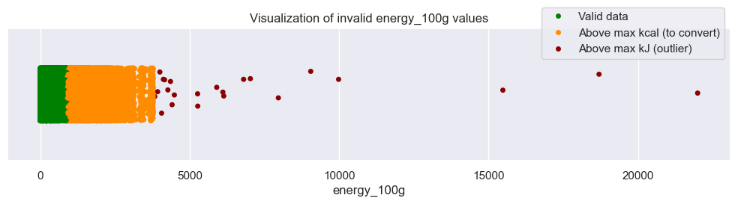
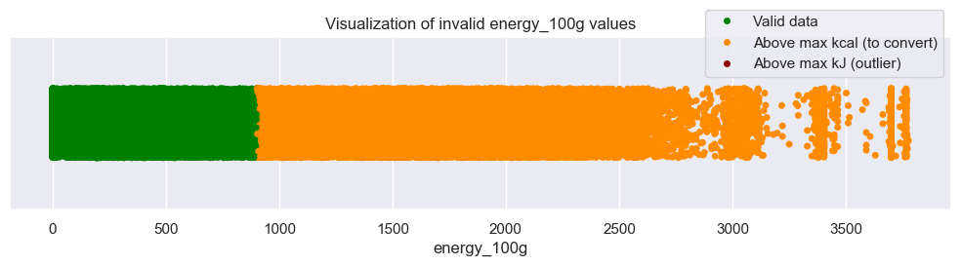
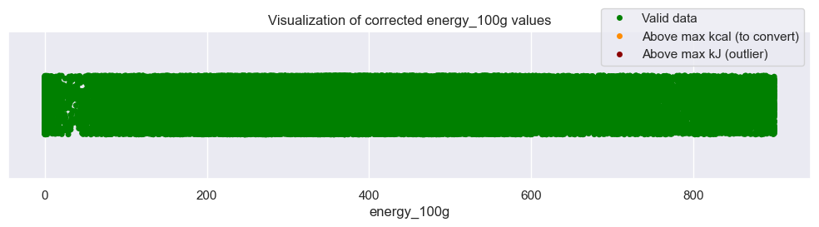
Outliers detection
Notes:
Outlier rules :
Nutrient > 100g -> NaN
Sodium > 40g (maximum in salt) -> NaN
Sum of macronutrients = Carbs + proteins + fats > 103 -> NaN
Sugars > Carbs -> Sugars = Carbs
Saturated fat > fat -> Saturated fat = fat
Energy: Several units mixed up (kcal and kJ)
Food giving the most energy (kcal) is pure fat : 1g = 9 kcal -> 100g = 900 kcal
Max kJ amount = 900 kcal * 4,2
Value < 900 : kcal, no action
900 < value < 3750 : kJ -> divided by 4,2
Value > 3750 -> NaN
IQR rule not suitable in this case

Slide 38
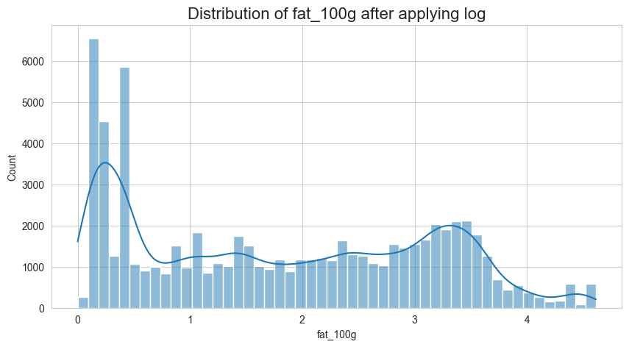
CompleteD dataset analysis
Multivariate analysis: PCA – Applying log to normalize data

Slide 39
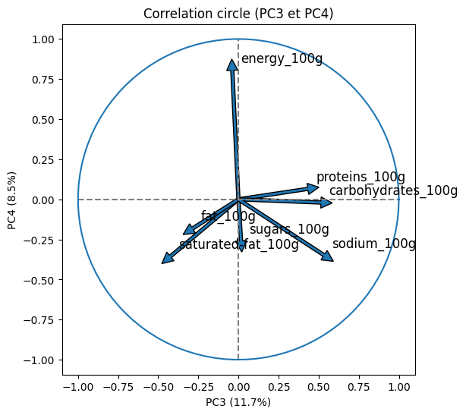
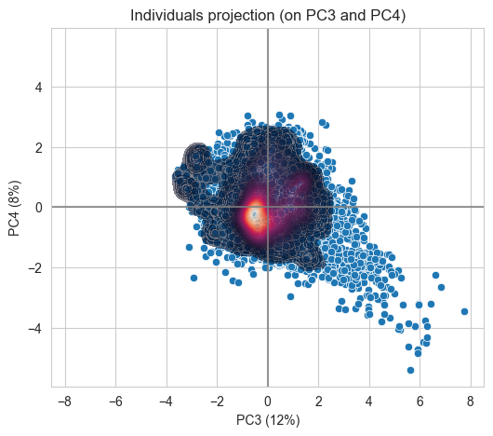
CompleteD dataset analysis
Multivariate analysis: PCA
Notes:
Interpretation:

